Slide 1
Apartment prices and venues data analysis in Seoul, South Korea
08, 23, 2020
Jina Song

Slide 2
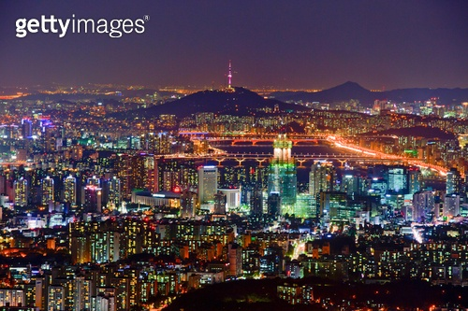
Introduction
Seoul is the largest city of Korea.
Like other large cities, housing costs in Seoul are difficult to deal with and varies greatly depending on the districts.
With obtainable Data
Goal : Check the correlation between the average housing price and the surrounding venue in Seoul.

Slide 3
Data
Geographic coordinates data of 25 districts in Seoul
Apartment price per 3.3m square of 25 districts in Seoul
Surrounding venues using a Foursquare API
Map information using a folium library in Python

Slide 4
K-means clustering
K = 5
Limit venues in each district : 100
Radius : 3000m
Total venues : 2319 venues for clustering

Slide 5
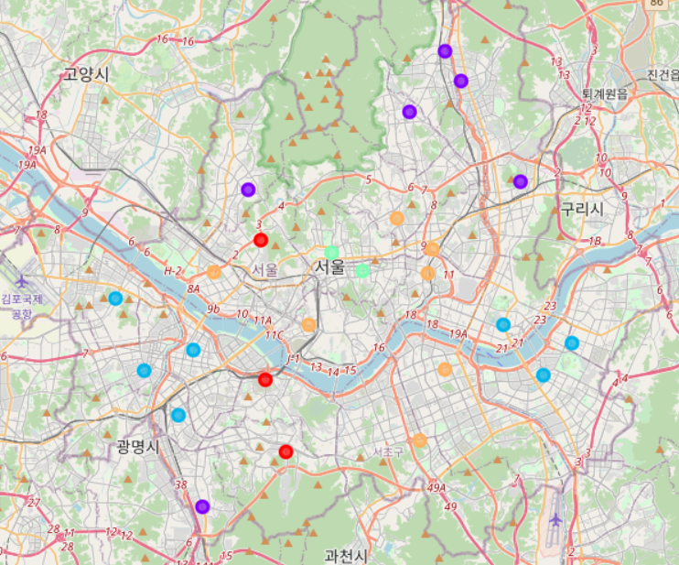
K-means clustering results
cluster | Most common venue
Red | Mixed
Purple | Fast food
Blue | Park
Green | Historic Place
Yellow | BBQ

Slide 6
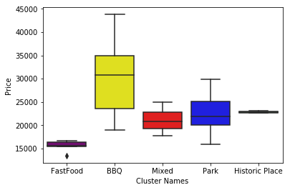
Correlation between clustering results and apartment prices

Slide 7
Conclusion
We can infer the apartment price according to what items dealt with in neighbors
These results will be a good guideline for not only house buyers but also who want to start a new restaurant.

